Slide 1


Hospital Outpatient Department (OPD) Business Process BSc in Management Information Systems (Special) IS204.3 Business Process Management Batch 22.2/ 23.1
Group Assignment – Group D
S.R.Y.T. Zoysa – 27599
M.L.D. Chathushka - 27727
P.K.K. Priyanwada – 27785
M.N.S. Malsinghe - 29150
N.M.H. Sathsara - 28461
G.D. T. Rashmika- 28582
N.W.P.R.N. Perera – 28898
K.D.S.S. Weerasinghe – 28045
D.GT.D. Samarathunga – 29040
D.S.N. Jayasinghe – 28934

Slide 2

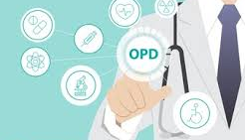
Overview of the selected Organization
Hospital is an organization that provides medical care to the people. It is organized based on departments and divisions, depending on the type of patients treated, treatments, and services rendered. The main purpose of a hospital is concern for the patients by way of admission, diagnosis of illnesses, treatment of diseases, and helping patients recover.
Scope of the Hospital Outpatient Department (OPD) Business Process
Entry and Registration of Patient
Queuing and Barcode Generation
Examination by the Doctor
Admission Decision Making
Billing Procedure
Insurance Handling
Medication Dispensing

Slide 3
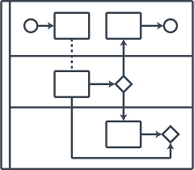
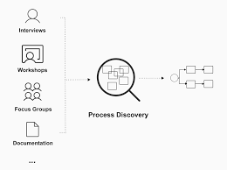
Process Discovery Methods
Interviews
Document Analysis
Process Observation
Automated Process Discovery
As-Is BPMN 2.0 Process Model
Participants: Patient, Registration Officer, Doctor, Billing Officer, Insurance Provider, Pharmacist
Key Steps:
Patient registration
Waiting in queue and doctor examination
Payment or insurance handling.
Medicine collection from the pharmacy.
Decision Points:
Admission required?
Direct payment or insurance claim?
End Event: Patient receives treatment or medication, completing the OPD visit.

Slide 4


Process Issues Identification
Time Issues | Cost Issues | Quality Issues
Manual Submission Take Time | Higher Labor Costs | Communication gap
Slow Updates on Claim Status | Cost of Reprocessing Claims | Low Customer Satisfaction
Long Waiting Times | Redundancy in receipts | Insurance claim denials

Slide 5
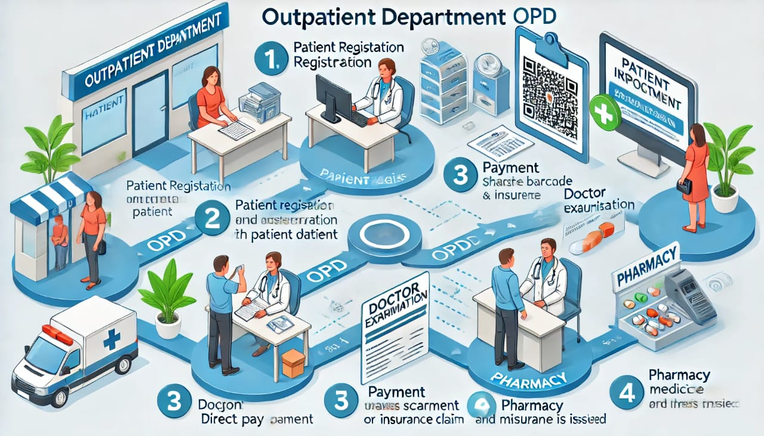


Performance Measures
Waiting Time
Patient Flow Efficiency
Cost of Services
Insurance Claims Process
Patient Satisfaction
Operational Costs
Quality of Care
Staff Performance
Proposed Solutions for Key Issues
Insurance Claiming Process
Time Issues
Cost Issues
Quality Issues

Slide 6
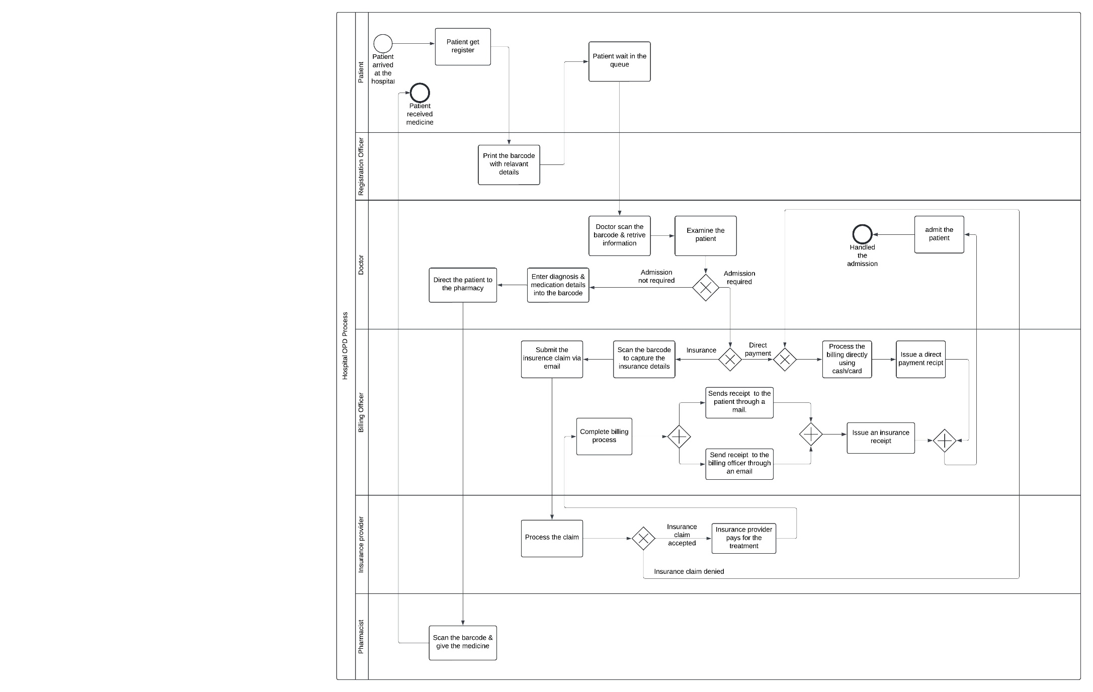
Redesign of the Hospital OPD Process
Redesign of the Insurance Process
Automation
Real-Time Updates
Fallback Plan
Addressing Identified Problems
Efficiency
Clear Communication
Handling Rejection
Improved Patient Experience

